Slide 1
TDD++
Test-driven Development with Groovy
Björn Beskow | bjorn.beskow@callistaenterprise.se | 2014-01-13

Slide 2

Logistics

Slide 3

Agenda
Unit Testing & TDD Basics
Groovy Basics
Groovy Unit Testing
Mocking collaborators
Assertions & matchers
Working with times and dates
Integration Testing
Managing test data
Working with SQL databases
API testing
Working with XML
Working with JSON
Acceptance Testing
Specifications
Specification By Example using FitNesse
Web Acceptance Testing

Slide 4

About Tests …
Everybody knows they should, but few actually do
“Why isn’t this tested before”?
Because it has been too expensive, difficult, cumbersome to test
Because we have been too busy

Slide 5
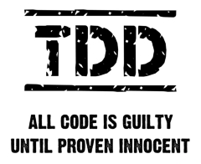
Quality Assurance precedes Quality Assessment
Testing is about Quality Assurance, not just Quality Assessment
Quality Assessment only indirectly affect quality
Testing reveals information
Testing helps focus project activity

Slide 6
Automated Tests must be
easy to write
easy to find
easy to run
easy to maintain
otherwise
they will slow you down
they will get left behind
you’ll go back to manual testing

Slide 7
Critical Success Factors
Repeatability and Consistency
Once the test is complete, it should pass repeatedly, whether it executes by itself or within a test suite.
When a completed test fails, we need to quickly and accurately pinpoint the cause: did the test uncover a bug in the system, or is the test itself faulty?
Readability
The tests are the definitive reference for the system requirements.
Maintainability
Sufficient test coverage usually yields as much (or more) test code than system code, hence we have to be as concerned (or more) with the maintenance costs of test code as compared to system code.

Slide 8
Classifying Automated Tests
Granularity
Entire system
Individual units
Point of Contact
Existing User Interface
Testability API
Test Case Production
Record and Play Back
Hand Written (programmatic)
R & PB
Program
Unit
System
API
GUI

Slide 9
Some aspects of Java may (sometimes) harm your productivity
public void testInsertDuplicateVisitShouldThrowException() {
Pet pet = new Pet();
List<Visit> visits = pet.getVisits();
Visit firstVisit = visits.get(0);
Visit copy = null;
try {
copy = (Visit) firstVisit.clone();
} catch (CloneNotSupportedException e) {
// Should never happen
}
copy.setId(0);
visits.add(copy);
this.clinicService.saveVisit(copy);
try {
this.clinicService.savePet(pet);
fail("DataIntegrityViolationException expected");
} catch (DataIntegrityViolationException e) {
// Expected
}
}

Slide 10
Groovy Basics
Groovy is a dynamic Java derivative on and for the JVM
Dynamically typed, with optional static typing
Compiles directly down to bytecode
Inspired by other dynamic OO languages: Smalltalk, Ruby, Python
Totally object-oriented
Goal is to greatly simplify the life for developers, without a steep learning curve

Slide 11
Syntax basics: A Java program
public class HelloWorld {
private String name;
public String getName() {
return name;
}
public void setName(String name) {
this.name = name;
}
public String sayHello() {
return "Hello, " + name + "!";
}
public static void main(String[] args) {
HelloWorld helloWorld = new HelloWorld();
helloWorld.setName("Groovy");
System.out.println(helloWorld.sayHello());
}
}

Slide 12
Corresponding Groovy program
public class HelloWorld {
private String name;
public String getName() {
return name;
}
public void setName(String name) {
this.name = name;
}
public String sayHello() {
return "Hello, " + name + "!";
}
public static void main(String[] args) {
HelloWorld helloWorld = new HelloWorld();
helloWorld.setName("Groovy");
System.out.println(helloWorld.sayHello());
}
}

Slide 13
Syntax: What is the same?
Keywords and statements (but Groovy adds in and def)
Try/catch/finally exception handling
Class, interface, field and method definitions
Packaging and imports
Operators, expressions and assignments
Control structures
Annotations, Generics, Enums

Slide 14
Syntax Gotchas: Subtle differences
Array literals: Java: String[] languages = {"java", "groovy", "perl"}; Groovy: String[] languages = ["java", "groovy", "perl"]
Equals and identity: Java: x.equals(y) Java: x == y Groovy: x == y Groovy : x.is(y)

Slide 15
Optional embellishments
Parentheses, return statements and semicolons are optional, as long as the result is unambiguous
public class HelloWorld {
public String sayHello() {
"Hello!"
}
public static void main(String[] args) {
HelloWorld helloWorld = new HelloWorld()
println helloWorld.sayHello()
}
}

Slide 16
Optional import statements
Import statements are optional for the following packages:
groovy.lang.*
groovy.util.*
java.lang.*
java.util.*
java.net.*
java.io.*
java.math.BigDecimal, java.math.BigInteger

Slide 17
Classes and free scripts
Everything in Groovy must be a class.
If Groovy code is not within an explicit class (a.k.a. a free script), it is automatically placed within a new, anonymous class derived from groovy.lang.Script

Slide 18
Groovy Beans: Properties
In Groovy, a JavaBean have true properties
Syntax support for property access
Corresponding getter and setter method generated automatically
public class HelloWorld {
String name
public String sayHello() {
return "Hello, " + name + "!"
}
public static void main(String[] args) {
HelloWorld helloWorld = new HelloWorld()
// helloWorld.setName("Groovy")
helloWorld.name = "Groovy"
println(helloWorld.sayHello());
}
}

Slide 19
Groovy Beans: Named Parameters
Named parameters for constructors, which sets the corresponding JavaBeans properties
Visit v = new Visit(description:'Broken tail', price: 480.00)
instead of
Visit v = new Visit()
v.description = 'Broken tail'
v.price = 480.00

Slide 20
Groovy Strings (GStrings)
Variable interpolation in strings using $ notation: int age = 20 println "Age: ${age}"
" enclosed strings performs variable interpolation, ' enclosed strings doesn’t: println 'Literal ${value}'
""" for multiline strings: println """This is a string that spans several rows"""

Slide 21
Lists, Maps and Ranges
Lists
List list = [1,2,3,4,5]
println "first element is ${list[0]}"
println "last element is ${list[-1]}”
list << 6 List sublist = list[2..4]
Maps
Map frameworks = [groovy:"Grails", ruby:"Rails"]
println """The groovy framework is
${frameworks['groovy']}"""
Ranges
for (i in 1..10) {
println "$i"
}

Slide 22
Running Groovy
Using groovysh
Using groovyConsole
Using dynamic compiling with groovy: c:> groovy HelloWorld.groovy
Using the groovyc joint compiler and java: c:> groovyc HelloWorld.groovy c:> java –cp %GROOVY_HOME%\embeddable\groovy-all-2.0.7.jar;. HelloWorld
Using the groovyc joint compiler and JUnit: c:> groovyc HelloWorldTest.groovy <ant|maven|gradle|...>

Slide 23
Exercise 1 – Gettings started
Import the project named 'groovy-tdd-cadec' (File -> Import -> Maven-> Existing Maven Project into workspace)
Create a Groovy script HelloTutorial.groovy (File -> New -> Groovy class, select ”Create Script”)
Add a method sayHello that takes a name as parameter and returns a greeting. Call the method to print the greeting
Run the class (Run as -> Groovy Script or Run as -> Java Application)
Run the class from the command line
Open Groovy Console, copy/paste the class into the console and run it from there

Slide 24
Unit Tests
Black-box or White-box test of a logical unit, which verifies that the logical unit behaves correctly – honors its contract.
A self-contained software module (typically a Class) containing one or more test scenarios which tests a Unit Under Test in isolation.

Slide 25
JUnit Test Example
public interface Account {
public void withdraw(double amount);
public void deposit(double amount);
public double balance();
//...
}
public class AccountImplTest {
@Test
public void withdraw() {
AccountImpl account = new AccountImpl("1234", 2000);
account.withdraw(300);
Assert.assertEquals(1700, account.balance());
}
@Test
public void withdrawTooMuch() { ... }
//...
}
}

Slide 26
Exercise 2 – Basics
Write a Unit Test for org.springframework.samples.petclinic.util.PriceCalculator
Verify that pets older than 3 years pay an additional 20%
Verify that from 3rd visit, you get 20% rebate
Utilize the Groovy language syntax constructs for creating test data

Slide 27
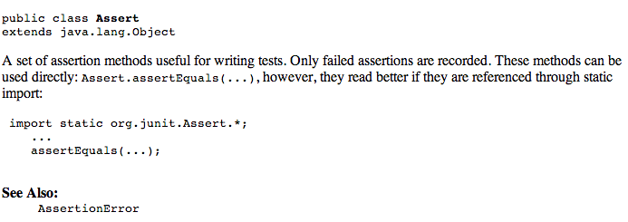
JUnit Assert woes

Slide 28
JUnit Assert woes
Node xml = ...
String expected = "y";
String actual = xml.getText();
assertEquals(expected, actual);
assertTrue("Node is invalid", xml.isValid());

Slide 29
Groovy Power Assert
assert is a Java keyword, but of limited use
In Groovy, the output of a failing assert provides extremely readable output:
def xml = new XmlParser().parseText("<test>x</test>")
assert "y" == xml.text()
Assertion failed: assert "y" == xml.text()
| | |
| | x
| test[attributes={}; value=[x]]
false

Slide 30
Groovy Power Assert
def xml = ...
assert xml.valid, "xml is invalid”
java.lang.AssertionError: xml is invalid.
Expression: xml.valid

Slide 31
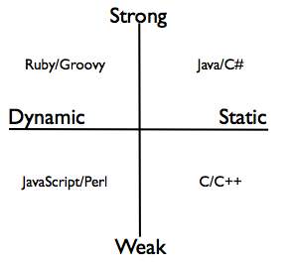
Dynamic vs Static Typing

Slide 32
Dynamic Typing (a.k.a Duck Typing)
”If it walks like a duck and quacks like a duck, it is probably a duck”
public class HelloWorld {
def person
public String sayHello() {
return "Hello, " + person.name + "!"
}
}

Slide 33
Optional static typing
Static types may be optionally provided:
def x = 25
int y = 50
println x + y
Useful for interoperability with Java

Slide 34
AST transformations: @TypeChecked
Brings Static Type Checking into the dynamic world of Groovy
Compiler performs sophisticated type inference

Slide 35
AST transformations: @CompileStatic
One step further:
Statically compile a class or block of code, which makes the bytecode (almost) identical to corresponding compiled Java code, with identical performance
Can prevent dynamic behavior to be inadvertently applied to a block of code (a.k.a. “Monkey Patching”)

Slide 36
Exercise 3 – Asserts and Dynamic Typing
Update your recent test to use Groovy asserts and Dynamic Typing

Slide 37
Groovy Closures
A reusable / assignable block of code delimitated by curly braces
Can take parameters
Can be assigned to a variable
Can be passed as parameters to methods, or inlined
Can refer to its surrounding context
def greeting = "Hello"
def printGreeting = {toWhom ->
println "${greeting} ${toWhom}" }
printGreeting("Groovy")
["Björn", "Magnus", "Peter"].each {
printGreeting( it )
}

Slide 38
Closures in typical action
Capture prototypical usage, and provide the essential work as a closure:
def sql = new Sql(dataSource)
def list = sql.eachRow("select * from USER") {
println it.name
}
Iterating over collections, performing essential work for each item:
List<Orders> orders = ...
orders.each { order ->
if (order.valid()) order.dispatch()
}

Slide 39
Iterables in Groovy
Every object that implements Iterator provides numerous useful methods that iterates over the items using a closure:
def list = []
5.times {
list << it
}
list.each { println it }
assert list.any { it == 3 }
assert list.every { it >= 0 }
assert list.collect { it * it } == [0, 1, 4, 9, 16]
assert list.findAll { it > 1 && it < 4 } == [2, 3]
assert list.find { it > 1 } == 2
assert (1..9).findAll {it % 2 == 1} == [1,3,5,7,9]

Slide 40
Exercise 4 – Asserts and Dynamic Typing
Update your recent test to use a closure to create dynamic test data

Slide 41

Test Doubles
Frequently used technique to
Isolate code under test
Make test execute faster
Make execution deterministic
Simulate special conditions

Slide 42
Test Doubles come in different flavors
Dummy objects are passed around but never actually used.
Fake objects actually have working implementations, but usually take some shortcut.
Stubs provide canned answers to calls made during the test.
Spies are stubs that also record some information based on how they were called.
Mocks are pre-programmed with expectations which form a specification of the calls they are expected to receive.

Slide 43
Test Doubles in Java: Mockito et. al.
public interface ConfirmationService {
public void sendConfirmationMessage(Visit visit);
}
public void saveVisit(Visit visit) throws DataAccessException {
visitRepository.save(visit);
try {
confirmationService.sendConfirmationMessage(visit);
} catch (Throwable t) {
log.error("Failed to send confirmation message", t);
}
}
@Test
public void testSaveVisitSendsConfirmation() {
VisitRepository visitStub = Mockito.mock(VisitRepository.class);
ConfirmationService cMock = Mockito.mock(ConfirmationService.class);
ClinicServiceImpl service = new ClinicServiceImpl(null, null, null, visitStub, cMock);
service.saveVisit(visit);
Mockito.verify(confirmationMock).sendConfirmationMessage(visit);
}

Slide 44
Mocks using Groovy Closures
A Closure may be used as an implementation of a Java interface method
A Map of closures may be used as implementations of different methods in an Interface
def visitStub = {true} as VisitRepository
def confirmedVisit
def confirmationMock =
[sendConfirmationMessage: { v -> confirmedVisit = v }]
as ConfirmationService
...
assert confirmedVisit == visit

Slide 45
Exercise 5 – Groovy Interactions
Write a unit test for saveVisit() in org.springframework.samples.petclinic.service.ClinicServiceImplTest:
Stub out the VisitRepository
Mock ConfirmationService, and verify that a confirmation is sent on saving a visit

Slide 46
Working with Exceptions
Unexpected exceptions thrown during execution of a test will be caught by the JUnit framework and reported as Errors.
A Test method must declare that it throws any checked exceptions that the Unit under Test may throw. If there are several checked exceptions that may occur, it is perfectly valid for a test method to declare throwing java.lang.Exception.
Expected exceptions (exceptions that the test is expecting the Unit under Test should throw in a certain situation) are expressed using the @Test(expected=ExpectedException.class) attribute
@Test(expected=NastyException.class)
public void doSomethingNastyTest() {
SomeUnit target = new SomeUnit();
target.doSomethingNasty();
}

Slide 47
Working with Exceptions (Contd.)
Or using the following idiom:
SomeUnit unitUnderTest = new SomeUnit();
try {
unitUnderTest.doSomethingNasty();
fail("NastyException expected");
} catch (NastyException expected) {
// Expected
}
assertTrue("Invariant violated", unitUnderTest.isValid());

Slide 48
In Groovy, we can do better:
SomeUnit unitUnderTest= new SomeUnit()
shouldFail(NastyException) {
unitUnderTest.doSomethingNasty()
}
assert unitUnderTest.valid, "Invariant violated"

Slide 49
Simulating exceptional situations
public void saveVisit(Visit visit) throws DataAccessException {
...
visitRepository.save(visit);
...
}
@Test
public void testSaveVisitThrowsDataAccessException() {
def visitStub = {
throw new DataIntegrityViolationException("Oops")
} as VisitRepository
...
}

Slide 50
Exercise 6 – Simulating Exceptions
Add a test method for saveVisit() to verify that a DataAccessException is passed through from the underlying VisitRepository collaborator

Slide 51
Injecting collaborators
Logger loggerMock = mock(Logger.class);
ClinicServiceImpl service = new ClinicServiceImpl(...);
ReflectionUtils.setStaticAttribute(ClinicServiceImpl.class,
"log", loggerMock);
service.saveVisit(visit);
verify(loggerMock).error(anyString(), any(Throwable.class));

Slide 52

Meta-programming: Meta Object Protocol
Meta-programming: ≈ ”programming the program”
enables extensions to a program at runtime
Groovy gives every class or instance a metaClass property, which allows you to
Add methods and properties
Intercept missing methods
Extremely powerful mechanism, which provides the foundation for DSLs and Builders

Slide 53
The MetaClass
Obtain a Class’ MetaClass with: def metaClass = String.metaClass
Obtain an object’s MetaClass with:
String s = "Hello"
def metaClass = s.metaClass
The MetaClass provides information about the Class or object:
String.metaClass.methods.each {println it.name}
String.metaClass.properties.each {println it.name}

Slide 54
ExpandoMetaClass
The MetaClass is actually an extensible Metaclass (a.k.a. ExpandoMetaClass), which allows us to dynamically add methods, properties and fields:
class Dog {
private String secret = "...";
}
Dog.metaClass.bark = { "Woof!" }
println new Dog().bark()
def dog = new Dog()
dog.metaClass.getBreed = { "Poodle" }
println dog.breed
Dog.metaClass.setAttribute(dog, "secret", "42")

Slide 55
ExpandoMetaClass
Add static methods using the static prefix:
Dog.metaClass.static.create = { new Dog() }
Add constructors using the constructor prefix:
Dog.metaClass.constructor = {n -> new Dog(name:n)}

Slide 56
Exercise 7 – Injecting Collaborators
Add a test method for saveVisit() to verify that an exception thrown from the ConfirmationService collaborator is properly handled by logging the exception
Create a Mock object for the logger
Inject the logger using metaClass.setAttribute

Slide 57
Meta Hooks
The MetaClass also allows intercepting and overriding key dynamic method dispatch hooks:
invokeMethod()
set/getProperty()
methodMissing()
propertyMissing()

Slide 58
Overriding methodMissing
Overriding the methodMissing method allows for dynamic creation of capabilities and behavior:
class Dog {}
Dog.metaClass.methodMissing = {String name, args ->
Dog.metaClass."$name" = {Object[] varargs->
"dynamic $name"
}
"dynamic $name"
}
assert new Dog().howl() == "dynamic howl"
assert new Dog().crawl() == "dynamic crawl"

Slide 59
Intercept, Cache, Invoke idiom
Typical idiom when overriding the methodMissing: Intercept, cache a dynamically created method, then invoke it:
class Dog {}
Dog.metaClass.methodMissing = {String name, args ->
Dog.metaClass."$name" = {Object[] varargs->
"cached $name"
}
"dynamic $name"
}
assert new Dog().howl() == "dynamic howl"
assert new Dog().howl() == "cached howl"

Slide 60
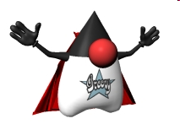
Groovy Development Kit
Cool! I’d like to have the same expressive power in the standard Java APIs.
But we can’t extend java.lang.String or java.io.File, can we?
Yes we can, using the metaClass of the MOP!
The Groovy Development Kit (GDK) is a pimped JDK!
http://groovy.codehaus.org/groovy-jdk/

Slide 61
Builders
The need to produce and work with hierarchical (tree) structures are everywhere
XML documents
Configuration files
Ant tasks
GUI Components
The Builder pattern can be used to construct such hierarchical data structures
Trivial and elegant to implement in Groovy using methodMissing(), closures and chained method calls

Slide 62
XML Builder example
def builder = new groovy.xml.MarkupBuilder()
builder.employees {
employee(name:'Björn') {
address(street:'Vallhamnsgatan', city:'Västra Frölunda')
phone('0733-519173')
}
}
produces
<employees>
<employee name='Björn'>
<address street='Vallhamnsgatan' city='Västra Frölunda' />
<phone>0733-519173</phone>
</employee>
</employees>

Slide 63
ObjectGraphBuilder example
def builder = new ObjectGraphBuilder()
builder.classNameResolver =
"org.springframework.samples.petclinic.model"
visit = builder.visit(
date: DateTime.now(),
description: "visit description",
{ pet(name: "a pet",
{ petType(name: "type") },
{ owner(firstName: "firstName",
lastName: "lastName",
address: "address",
city: "city",
email: "name@gmail.com") } )
})

Slide 64
Parsing and navigating XML
Given the following XML:
def xml = """<employees>
<employee name='Björn'>
<phone>0733-519173</phone>
</employee>
<employee name='Johan'>
<phone>0733-519175</phone>
</employee>
</employees>"""
Parsing the XML and navigating the object graph using GPath is simple:
def root = new XmlParser().parseText(xml)
println root.employee[1].phone.text()
println root.employee.findAll{ it['@name'] =='Björn' }

Slide 65
Exercise 8 – Verifying XML content
Add a test method to the org.springframework.samples.petclinic.service.ConfirmationServiceImplTest that verifies that sendConfirmationMessage() results in an properly formatted XML message is sent to the correct recipient

Slide 66
Typical Unit test scenario – The Three A’s
Arrange - Instantiate Unit under Test and set up test data
Act - Execute one or more methods on the Unit Under Test
Assert - Verify the results
@Test public void testWithdraw() { AccountImpl account = new AccountImpl("1234", 2000); // Arrange account.withdraw(300); // Act assertEquals(1700, account.balance()); // Assert }

Slide 67

Spock
A Groovy-based testing framework
Fully compatible with JUnit
Utilizes the power of Groovy to
Reduce the lines of test code
Make tests more readable
Turn tests into specifications

Slide 68
Spock: Basics
import spock.lang.*
class MyFirstSpecification extends Specification {
// fields
// fixture methods
// feature methods
// helper methods
}

Slide 69
Spock: Fields
class MyFirstSpecification extends Specification {
def obj = new ClassUnderSpecification()
def coll = new Collaborator()
@Shared res = new VeryExpensiveResource()
static final PI = 3.141592654
// fixture methods
// feature methods
// helper methods
}

Slide 70

Spock: Feature Methods
import spock.lang.*
class MyFirstSpecification extends Specification {
// fields
def setup() {} //run before every test
def cleanup() {} //run after every test
def setupSpec() {} //run before first test
def cleanupSpec() {} //run after last test
// feature methods
// helper methods
}

Slide 71
Spock: Feature Methods
class MyFirstSpecification extends Specification {
def "specification for a feature"() {
// blocks go here
}
}
A feature method consists of four phases:
Optional: Set up the feature's fixture
Provide a stimulus to the system under specification
Describe the response expected from the system
Optional: Clean up the feature's fixture

Slide 72
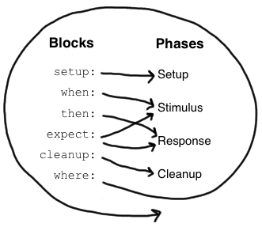
Spock: Feature Blocks
A block is a section of a feature method, prefixed by a label that describe the purpose of the section:
setup:
when:
then:
expect:
cleanup:
where:

Slide 73
Spock: Setup
class StackSpecification extends Specification {
def "specification for a stack"() {
setup:
def stack = new Stack()
def elem = "push me”
...
}
}

Slide 74
Spock: Given alias
class StackSpecification extends Specification {
def "specification for a stack"() {
given:
def stack = new Stack()
def elem = "push me”
...
}
}

Slide 75
Spock: Implicit setup
class StackSpecification extends Specification {
def "specification for a stack"() {
def stack = new Stack()
def elem = "push me”
...
}
}

Slide 76
Spock: Additional documentation
class StackSpecification extends Specification {
def "specification for a stack"() {
given: "an empty stack"
def stack = new Stack()
and: "an element that can be pushed"
def elem = "push me"
...
}
}

Slide 77
Spock: Triggers and Conditions
class StackSpecification extends Specification {
def "specification for a stack"() {
given: "an empty stack"
...
when: "an element is pushed" // stimulus
stack.push(elem)
then: "stack is not empty" // response
!stack.empty
and: "pushed element is on top"
stack.peek() == elem
}
}

Slide 78
Spock: Exception Conditions
Class StackSpecification extends Specification {
def "specification for a stack"() {
given:
...
when: "popping an empty stack"
stack.pop()
then: "an exception is thrown"
EmptyStackException e = thrown()
e.cause == null
}
}

Slide 79
Spock: expect
class StackSpecification extends Specification {
def "specification for a stack"() {
given: "a stack with one element"
def stack = new Stack()
def elem = "push me"
stack.push(elem)
expect: "pop returns that single element"
stack.pop() == elem
}
}

Slide 80
Spock: corresponding when/then
class StackSpecification extends Specification {
def "specification for a stack"() {
given: "a stack with one element"
def stack = new Stack()
def elem = "push me"
stack.push(elem)
when: "pop is called"
def popped = stack.pop()
then: "that single element is returned"
popped == elem
}
}

Slide 81
Exercise 9 – Spock basics
Write a Spock Specification for org.springframework.samples.petclinic.util.PriceCalculator
Was it worth it?

Slide 82
Spock: Data-driven testing
A feature method may be parameterized using a where block:
def "specification for a feature"() {
expect:
x == someFunction(y)
where:
x << xDataProvider
y << yDataProvider
}

Slide 83
Spock: Data-driven testing example
def "specification for square"() {
expect:
y == x * x
where:
x << [1,2,3,4]
y << [1,4,9,16]
}

Slide 84
Multi-parameterizations
def "specification for square"() {
expect:
y == x * x
where:
[x, y] << [[1,1], [2,4], [3,9], [4,16]]
}

Slide 85
Alternative syntax
def "specification for square"() {
expect:
y == x * x
where:
x | y
1 | 1
2 | 4
3 | 9
4 | 16
}

Slide 86
More elaborate example
@Unroll
def "frameworks #x, #y and #z are compatible"() {
expect:
areCompatible(x, y, z)
where:
[x, y, z] << [["junit", "mockito", "java"],
["junit", "mockito", "groovy"],
["junit", "easymock", "java"],
["junit", "easymock", "groovy"],
["spock", "mockito", "java"],
["spock", "mockito", "groovy"],
["spock", "easymock", "java"],
["spock", "easymock", "groovy"]]
}

Slide 87
... or more elegantly
@Unroll
def "frameworks #x, #y and #z are compatible"() {
expect:
areCompatible(x, y, z)
where:
[x, y, z] << [
["junit", "spock”],
["mockito", "easymock"],
["java", "groovy"]
].combinations()
}

Slide 88
Exercise 10 – Data-driven test
Transform your Spock Specification for org.springframework.samples.petclinic.util.PriceCalculator into a data-driven specification
Is it more readable?

Slide 89
Spock: Interaction-based testing
Spock provides built-in support for stubbing/mocking interactions using a highly readable syntax:
given:
def messageSender = Mock(MessageSender)
messageSender.isActive() >> true
when:
messageSender.setFormat("xml")
service.sendConfirmationMessage(visit)
then:
1 * messageSender.sendMessage(owner.email, _)

Slide 90
Exercise 11 – Spock Interactions
Write a Spock Specification for org.springframework.samples.petclinic.service.ConfirmationServiceImpl
Was it more readable?

Slide 91
Integration Tests
An Integration Test is any test which tests a logical unit together with other units that it depends on, such as other software units but more frequently external resources such as Databases or Message Queues.
Thus the integration tests share many of the characteristics of Unit Tests, but the granularity is much bigger.
Due to the performance costs in accessing external resources, the integration tests usually takes much longer time to execute.

Slide 92
Test Data, concurrency and repeatability
Integration tests which have side effects (i.e. which affects persistent data) are problematic:
Modifying data which other tests may depend on, may cause subsequent test failures
Several instances of tests which uses the same data may run concurrently, which may cause test failures
Transaction demarcation is a common idiom to protect test data from modification:
Start a transaction in @Before setUp()
Rollback the transaction in @After tearDown()

Slide 93
Working with SQL data in Java
The JDBC api is far to low-level. Hence add-on libraries such as DbUnit or Spring-test are necessary.
static boolean testDataSetup = false;
@BeforeTransaction
public void setupTestData() {
if (!testDataSetup) {
testDataSetup = true;
JdbcTemplate jdbcTemplate = new JdbcTemplate(dataSource);
Resource script =
new ClassPathResource("/db/hsqldb/populateDb.sql");
JdbcTestUtils.executeSqlScript(jdbcTemplate, script, true);
}
}

Slide 94
Working with SQL data in Groovy
import groovy.sql.Sql
sql = Sql.newInstance( 'jdbc:hsqldb:mem:petclinic',
'sa', '', 'org.hsqldb.jdbcDriver' )
sql.eachRow( 'select * from OWNER' ) {
println "$it.id -- ${it.firstName} --"
}
def sql = new Sql(dataSource.connection)
def insert = "INSERT INTO owners (id, first_name) VALUES (?, ?)”
sql.executeInsert(sql, [o.id, o.firstName])

Slide 95
Exercise 12 – Working with SQL
Modify the insertVisit() test method in org.springframework.samples.petclinic.service.ClinicServiceJpaTest to
Insert a test Pet using an SQL insert
Verify the inserted Visit entity using an SQL query

Slide 96
Acceptance Tests
Tests a system or part of a system from the outside, in terms of observable behavior
Typically structured around a comprehensible chunk of system functionality
Ideally written by the customer
Either written in terms of User Interface actions, or in terms of “words” and “facts”
Ideally run near 100% correct at the end of a release/project

Slide 97
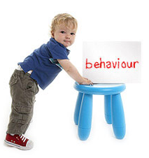
Business people wants to express the required behaviour, not necessarily write tests

Slide 98
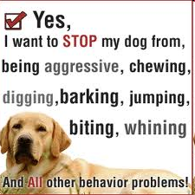
Then we should ...
State required behaviour in a precise enough way, using the vocabulary of the business

Slide 99

Then we should ...
State required behaviour using examples

Slide 100
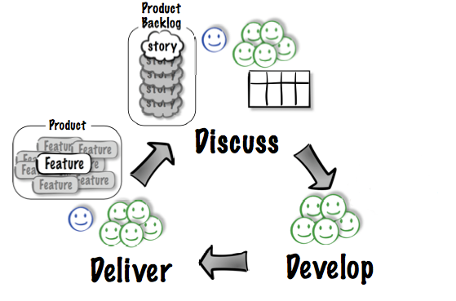
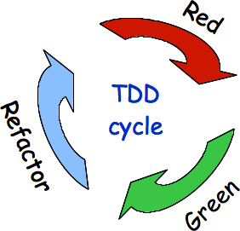
Acceptance Test Driven Development, a.k.a. Behavior Driven Development, a.k.a. Test Driven Requirements
Image courtesy Elisabeth Hendrickson, www.qualitytree.com

Slide 101

FitNesse: A standalone Wiki and FIT runner
Collaborative Testing and Documentation Tool, providing a very simple way to
create documents
specify tests
execute tests

Slide 102
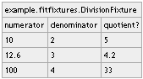
Minimal FitNesse example: Test table
!|example.fitfixtures.DivisionFixture|
|numerator |denominator |quotient? |
|10 |2 |5 |
|12.6 |3 |4.2 |
|100 |4 |33 |

Slide 103
Minimal example: SLIM Fixture
package example.fitfixtures
class DivisionFixture {
double numerator
double denominator
def quotient() {
numerator / denominator
}
}

Slide 104
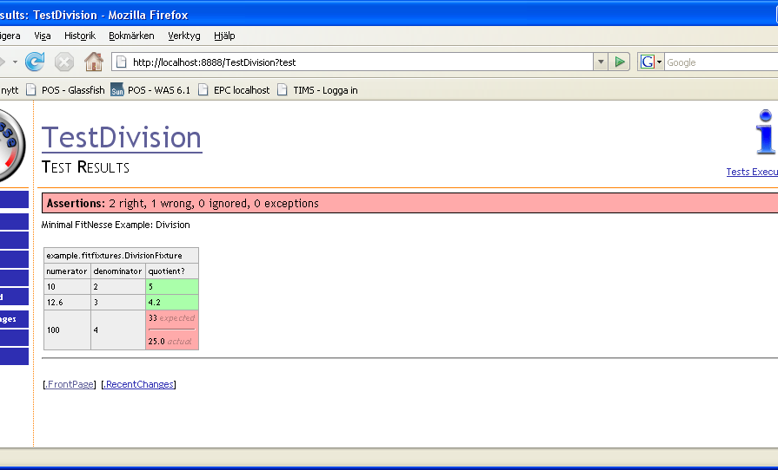
Minimal FitNesse example: Test execution

Slide 105
Exercise
Implement and run the test for the minimal Division example!

Slide 106
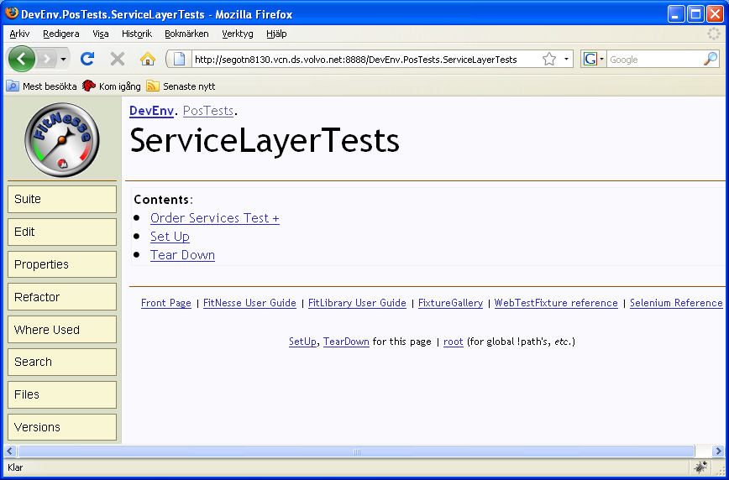
FitNesse: Wiki pages and Subpages
FitNesse is a Wiki Web Server
FIT tests lives on a Wiki page
FitNesse Wiki pages have hierarchical structure
FitNesse Wiki pages have additional metadata (a.k.a. “Properties”)

Slide 107
FitNesse: Wiki markup
Wiki words are in CamelCase: ThisIsAnExample
Hierarchy is expressed using . notation, or > and < for relative links:
.RootPage.SubPage.AnotherSubPage
>SubPage
<ParentPage
Simple markup for formatting
'''bold''' -> bold, ''italic'' -> italic
!c centers a line, !1 gives first heading !2 second heading
|cell 1|cell 2| specifies a table

Slide 108
FitNesse: Wiki markup (cont)
Escape wiki words using !- -!: !-ThisIsNotAWikiWord-!
Escape all content in a table using !: !|a.java.ClassName|
Special markup ‘widgets’:
!path
!contents –R2
!define

Slide 109
Fitnesse variables
FitNesse variables allow variable content to be specified once, then used in multiple tests
FitNesse variables are inherited from parent pages, if not defined explicitly (a.k.a. default inheritance)
Variable Definition
!define name {value}
!define name (value)
!define name [value]
Variable Usage
${name}

Slide 110
Hierarchical structure of variables

Slide 111
Symbolic links
Page structure forms a proper hierarchy (i.e. a tree)
Sometimes, variable information exists in several, crosscutting dimensions
E.g. environmental differences (Test environment vs. Production environment)
FitNesse Symbolic Links provide a way to introduce multiple inheritence between pages

Slide 112
Symbolic Links

Slide 113
Test Suites
A Test Suite is a page that has children containing tests (or other suites)
Test Suites can be executed, just as individual test pages. Doing so will execute each contained test page in sequence

Slide 114
Exercise
Add a variable pageName to the ParentPage, and use it in a welcome phrase on the page
Use the same variable on the ChildPage1
Override, then use the variable on the ChildPage2
Create two new toplevel pages ProdEnv and TestEnv, which both defines the variable envName
Create symbolic links from ProdEnv and TestEnv to ParentPage, in order to inherit this variable. Use the defined variable in ParentPage
Access the ParentPage via the symbolic parents ProdEnv and TestEnv, to verify that the variable value difffers

Slide 115
SetUp and TearDown
If a sibling page SetUp exists for a Suite or a Test (or any of its parents), that SetUp page will automatically be included before the actual test(s)
Correspondingly, if a sibling page TearDown exists for a Suite or a Test (or any of its parents), that TearDown page will automatically be included after the actual test(s)
If a sibling page SuiteSetUp exists for a Suite, that SetUp page will automatically be included once before the actual suite
Dito for SuiteTearDown

Slide 116
SetUp and TearDown example

Slide 117
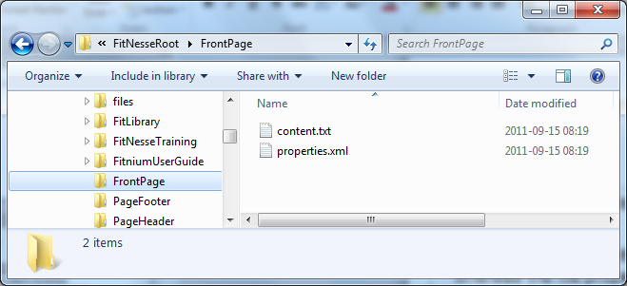
FitNesse technical storage details
A FitNesse page is stored as a folder, with the same name as the page.
The content.txt file within that folder stores the page content, whereas the file properties.xml stores the meta data

Slide 118
SLIM Fixture types
DecisionTable
For testing calculations: rows of data represent inputs and expected outputs
Query
For testing queries: rows of data represent an exact set of values (order-independently)
Script
Rows of data make up a script that emulates a series of events

Slide 119
Test types: Calculations
We frequently need to verify that calculations are being carried out correctly, according to some business rules.
Providing concrete examples of calculations help understand and disambiguate the underlying business rules.
A Calculation test states which inputs and outputs are involved in the calculation.
The bulk of the test then specifies example instances of the calculation

Slide 120
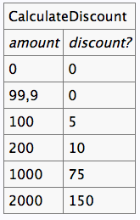
Example Calculation Test

Slide 121
Exercise: Calculations
Create test tables in Calculation style for frequent renter points calculations in the MovieRental application

Slide 122
Test types: Queries
Another type of test verifies that a query produces the expected result
A Query test states which result set properties are relevant to compare
The rest of the rows specifies the expected result set to be compared

Slide 123
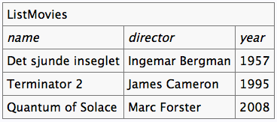
Example Query Test

Slide 124
Exercise: Queries
Create test tables in Calculation style for listing movie rentals per customer in the Volvo.MovieRental application

Slide 125
Test types: Sequences of actions
Another commontype of test verifies that a sequence of actions can be carried out according to expectations
The actions are typically steps in a business process
The actions are performed against an abstract device metaphor: data can be entered, buttons can pressed, displays can be checked (i.e. verified).
Note: The device metaphor should not be taken literally, i.e. the idea is not to test directly via an existing GUI.

Slide 126
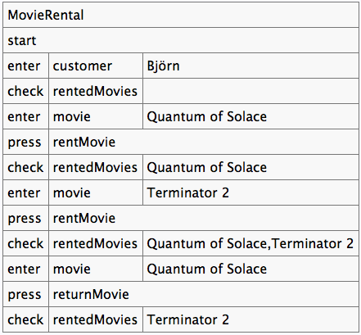
Example Sequences of Actions test

Slide 127
Exercise: Sequences of Actions
Create test tables in Action style for renting movies in the Volvo.MovieRental application

Slide 128
Record/Playback
A Test Automation tool records “events” that make up a Test Case into a Test Script
Events can be User Interface interactions or API calls
The scripts can be played back later for regression testing
R & PB
Program
Unit
System
API
GUI

Slide 129
Drawbacks of Record/Playback approaches
Tests tend to be fragile
Maintenance tends to be expensive
Complex, expensive tools
Tests cannot be pre-built

Slide 130

Testing Web User Interfaces is ...
… still a challenge

Slide 131


Hence we need some layers of abstraction
Specifications
DOM Abstraction
Browser Automation

Slide 132
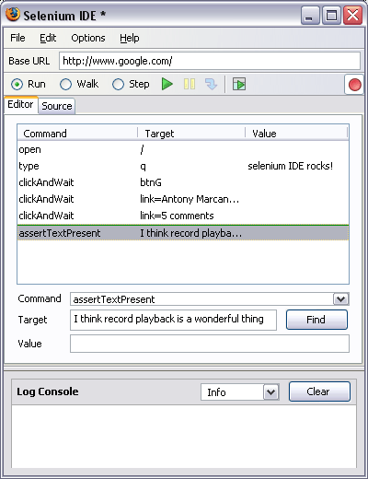
Selenium: A framework for Browser Automation
The Selenium engine executes tests directly in a browser, just as real users do.
The Selenium 1.0 test engine is implemented in JavaScript, and thus run in most browser (Internet Explorer, Mozilla, Firefox, Opera, Safari …) on most platforms.

Slide 133

Selenium + WebDriver = Selenium 2.0
First production-ready version in July 2011
Greatly enhanced model compared to Selenium 1.0
Object-based API for DOM Interaction
Browser Driver Implementations
Advanced User Interactions

Slide 134
At the heart of Selenium: Selenese

Slide 135

Browser Drivers
Native implementations of the WebDriver API
Firefox
Chrome
Internet Explorer
Opera
Headless (HtmlUnit)
iOS
Android
…

Slide 136


Selenium Remote Driver

Slide 137
Selenium Grid

Slide 138

DOM Abstraction: Geb
Brings together
The power of Selenium / Web Driver
The elegance of JQuery
The robustness of the Page Object pattern
The flexibility and pure joy of Groovy

Slide 139
Navigator API
JQuery-like expressions provide a concise and effective way to navigate the DOM
$("p", text: contains(”Timecard"))
$("input", name: "username").value("bjorn")
$("div.message").text()

Slide 140
Page Objects
Use proper object-orientation techniques to avoid brittleness and duplication
$("input", name: "username").value("bjorn")
$("input", name: "password").value("secret")
$("input", name: "submit").click()
Don’t do this

Slide 141
Page Objects
Use proper object-orientation techniques to avoid brittleness and duplication
page.login("bjorn", "secret")
Do this instead

Slide 142
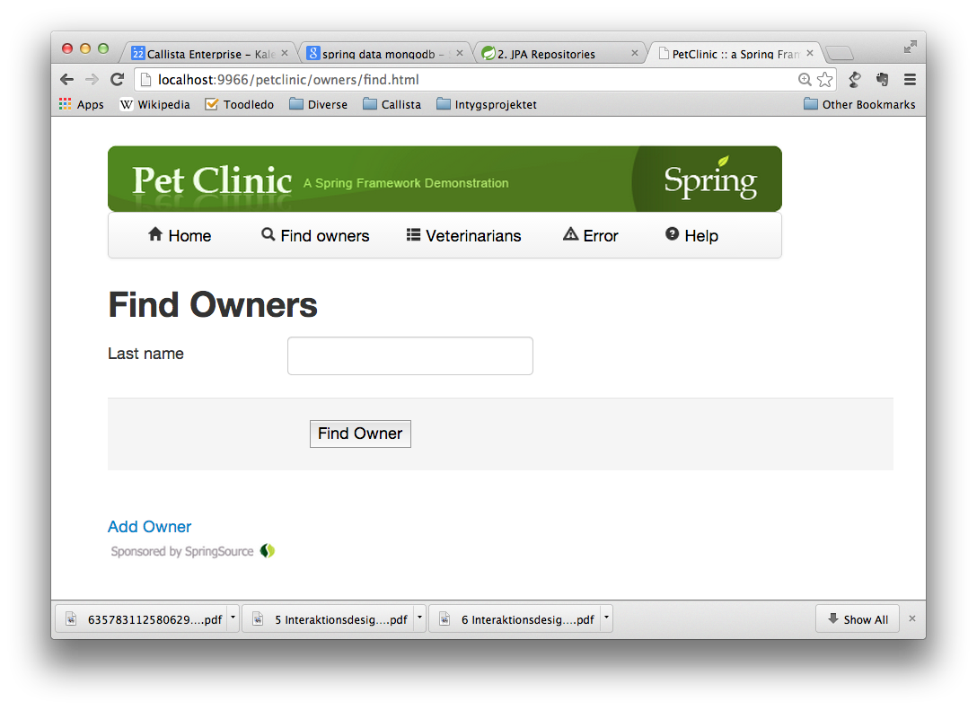

Slide 143
Geb Page definition
import geb.Page
class FindOwnersPage extends PetClinicPage {
static url = "owners/find.html"
static at = { $("h2").text() == "Find Owners" }
static content = {
lastName { $("input", name: "lastName") }
search { $("submit") }
}
def findByLastName(name) {
lastName.value(name)
search.click()
}
}

Slide 144
Geb Page definition: navigation
import geb.Page
class FindOwnersPage extends PetClinicPage {
static url = "owners/find.html"
static at = { $("h2").text() == "Find Owners" }
static content = {
lastName { $("input", name: "lastName") }
search { $("submit") }
}
def findByLastName(name) {
lastName.value(name)
search.click()
}
}

Slide 145
Geb Page definition: at predicate
import geb.Page
class FindOwnersPage extends PetClinicPage {
static url = "owners/find.html"
static at = { $("h2").text() == "Find Owners" }
static content = {
lastName { $("input", name: "lastName") }
search { $("submit") }
}
def findByLastName(name) {
lastName.value(name)
search.click()
}
}

Slide 146
Geb Page definition: logical content
import geb.Page
class FindOwnersPage extends PetClinicPage {
static url = "owners/find.html"
static at = { $("h2").text() == "Find Owners" }
static content = {
lastName { $("input", name: "lastName") }
search { $("submit") }
}
def findByLastName(name) {
lastName.value(name)
search.click()
}
}

Slide 147
Geb Page definition: actions
import geb.Page
class FindOwnersPage extends PetClinicPage {
static url = "owners/find.html"
static at = { $("h2").text() == "Find Owners" }
static content = {
lastName { $("input", name: "lastName") }
search { $("submit") }
}
def findByLastName(name) {
lastName.value(name)
search.click()
}
}

Slide 148

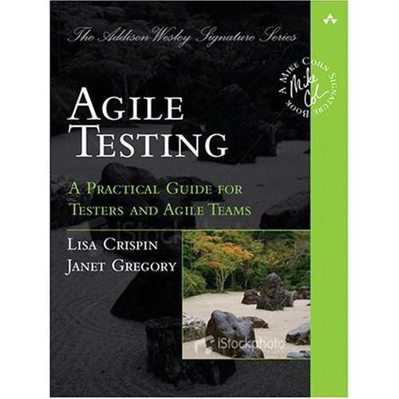
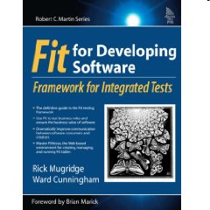
Resources

Slide 149

Questions

Slide 150
Other syntactic sugar
Named parameters to constructors
Employee e = new Employee(name:'Björn', phone:'0733-519173')
The Safe Dereferencing operator ?.
def list = ["groovy", null, "ruby", null, "c"]
list.each { println it?.toUpperCase() }
// equivalent to
list.each { if (it != null) println it.toUpperCase()
else println null }
The Spread operator *.
def list = ["groovy", "ruby", "c"]
list*.toUpperCase().each { println it }
// equivalent to
list.collect{ item -> item.toUpperCase() }.each { println it }

